Slide 1
ATP Tennis Data Analysis

Slide 2
ATP Tennis Data Analysis
ATP Tennis Project Data Analysis
Project Overview
Project Management
Setup Environment
Data Acquisition
Create Main Database and Tables
Load Data into Main Database
Create Data Warehouse
Populate Data Warehouse
Data Cleaning and Transformation

Slide 3
ATP Tennis Data Analysis
Data Analysis in Power BI
Visualization - Matches Won
Visualization - Match Duration
Visualization - Aces Hit
Conclusion

Slide 4
ATP Tennis Project Data Analysis
Project Title: Clearly conveys the main focus and topic of the presentation
Subtitle: Provides additional context and details about the project scope
Your Name: Identifies the presenter and their expertise on the subject matter

Slide 5
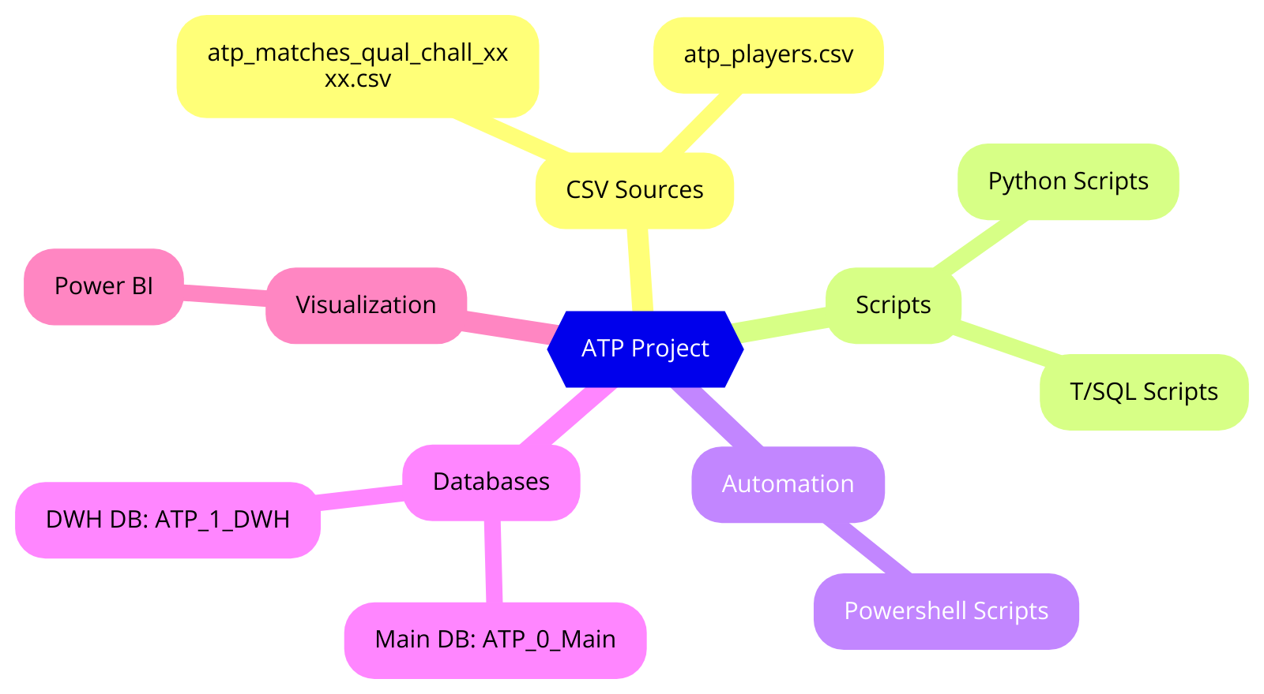
Project Overview
Key Objectives: Defines the primary goals and insights the analysis aims to uncover
Data Sources and Tools: Highlights the various data platforms and analytical tools leveraged for the project
Methodology Overview: Outlines the high-level approach used to extract, transform, and analyze the data
Project Tree View

Slide 6

Project Management
Task Breakdown in ProjectLibre: Enables detailed planning and organization of project tasks for efficient execution
Task Tracking and Monitoring: Provides visibility into project progress and helps identify potential roadblocks
Risk Management Examples: Highlights how ProjectLibre can mitigate issues like data inconsistencies and script errors
Photo by Jonathan Borba on Pexels

Slide 7

Setup Environment
SQL Server 2022 Installation: Ensures reliable data storage and querying for the project
Python and PowerShell Setup: Enables advanced data processing and automation for the analysis
Required Libraries: pandas, numpy: Provides powerful data manipulation and numerical computing capabilities
Photo by Min An on Pexels

Slide 8
Data Acquisition
Download ATP Matches and Players CSVs: Obtain the necessary data files from the ATP website to power the analysis
Organize Data into Directories: Establish a structured file system to store and manage the CSV files for efficient access and processing
Automate File Transfer and Extraction: Leverage scripting tools to streamline the data download and organization process, ensuring consistency and repeatability

Slide 9

Create Main Database and Tables
Importance of Database Structure: Establishes a robust, scalable data storage system to support comprehensive analysis
Efficient Data Management: Enables seamless organization, retrieval, and manipulation of large tennis datasets
Scalability and Flexibility: Allows the database to accommodate future data growth and evolving analytical needs
Photo by Tima Miroshnichenko on Pexels

Slide 10

Load Data into Main Database
Load CSV Data into SQL Server: Enables efficient data storage and querying for comprehensive analysis
Execute Python Script with PowerShell: Automates the data loading process, ensuring consistency and repeatability
Leverage Scripting Tools: Streamlines the overall data acquisition and processing workflow
Photo by Lukas on Pexels

Slide 11
Create Data Warehouse
SQL Script for Data Warehouse: Provides the technical details to create a robust data storage system for comprehensive analysis
Significance of Data Warehouse: Enables efficient data management, scalability, and flexibility to support evolving analytical needs
Centralized Data Repository: Facilitates seamless organization, retrieval, and manipulation of large tennis datasets for in-depth insights

Slide 12

Populate Data Warehouse
Python Script for Data Warehouse Population: Automates the process of extracting data from the Main Database and loading it into the Data Warehouse, ensuring consistent and reliable data transfer.
PowerShell Script to Execute Python Script: Leverages the flexibility and automation capabilities of PowerShell to seamlessly run the Python script, streamlining the overall data processing workflow.
Scripting Tools for Efficiency and Repeatability: Enables the use of scripting languages to automate data acquisition, processing, and loading tasks, ensuring consistency and reducing the risk of manual errors.
Photo by Chanaka on Pexels

Slide 13
Data Cleaning and Transformation
Data Cleaning Techniques: Explains how to identify and address data quality issues, such as missing values, outliers, and inconsistencies, using SQL or Python.
Data Transformation Examples: Showcases specific data transformation operations, like data type conversions, feature engineering, and data aggregation, to prepare the data for analysis.
Importance of Data Preparation: Highlights how effective data cleaning and transformation are crucial steps to ensure the reliability and accuracy of the analysis.

Slide 14

Data Analysis in Power BI
Connecting Power BI to ATP_1_DWH: Enables seamless data integration and visualization for comprehensive analysis
Analyzing Player Performance: Uncovers insights into player statistics, rankings, and match outcomes
Identifying Tournament Trends: Reveals patterns and insights about tournament attendance, viewership, and revenue
Photo by Markus Spiske on Pexels

Slide 15

Visualization - Matches Won
Matches Won by Players (2010-2017): Analyzing the number of matches won by players over an 8-year period provides valuable insights into their performance and dominance in the sport.
Visualizing Player Achievements: Creating a visual representation of the most matches won helps highlight the top-performing players and their sustained success during the given timeframe.
Identifying Trends and Patterns: The visualization can uncover trends in player performance, allowing for a deeper understanding of the competitive landscape in professional tennis.
Photo by Anna Tarazevich on Pexels

Slide 16
Visualization - Match Duration
Average Match Duration: Analyzing the typical length of best-of-3-set matches provides insights into the physical demands and pacing of professional tennis.
Factors Influencing Match Duration: Exploring factors like player styles, surface types, and tournament stages can reveal patterns and strategies that impact match lengths.
Implications for Tournament Scheduling: Understanding the average match duration can aid in optimizing tournament schedules and planning for efficient event management.

Slide 17

Visualization - Aces Hit
Top Players by Aces (2010-2017): Visualizing the players with the most aces over an 8-year period highlights the most dominant server in professional tennis during this timeframe.
Correlation Between Aces and Other Metrics: Exploring the relationship between aces and other performance metrics, such as service games won or win percentage, can provide deeper insights into the importance of serving in tennis.
Trends in Ace Counts Over Time: Analyzing how the number of aces by top players has changed over the years can reveal shifts in serving strategies, court surfaces, or equipment advancements that have influenced this statistic.
Photo by RICARDO MAYORAL ESCOBEDO on Pexels

Slide 18
Conclusion
Key Findings: The analysis reveals insights into player performance, tournament trends, and the importance of serving in professional tennis.
Future Work and Improvements: The project can be expanded to include more years of data, analyze additional performance metrics, and explore the impact of player injuries and other factors on match outcomes.
Significance of the ATP Project: The comprehensive data analysis provides valuable insights that can inform strategic decision-making for tournament organizers, coaches, and players, ultimately enhancing the overall competitiveness and fan engagement in professional tennis.

